Slide 1
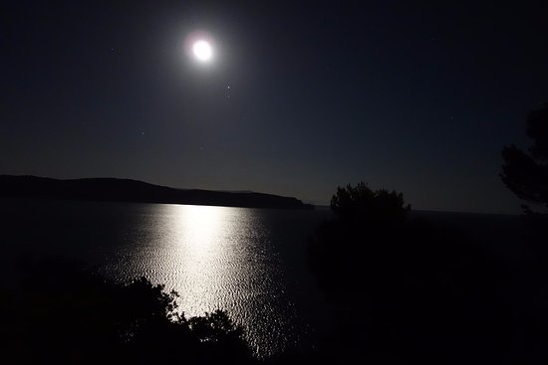
Dark matter searches at (low energy) accelerators
Paolo Valente – INFN Roma
XIV Seminar on Software for Nuclear, Subnuclear and Applied Physics
Porto Conte, Alghero, Italy
4-9 June 2017

Slide 2
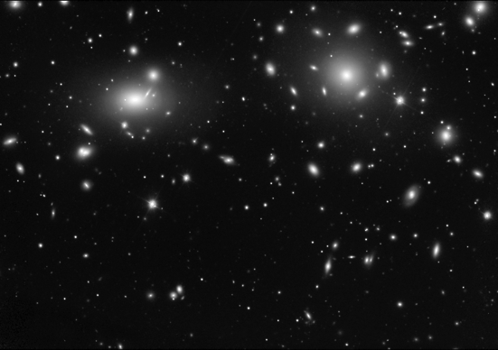
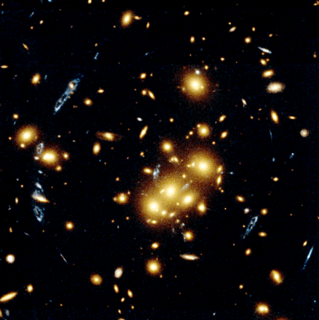
The long quest for dark matter
Zwicky, Coma cluster (1933)
M/L ≈ 660 M/L
Hubble Space Telescope (2007)
Cluster Cl 0024+17
Lensing of background galaxies

Slide 3
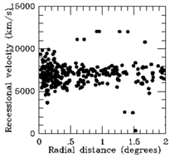
Estimate masses using velocities
Σ_{i} m_{i} <v_{i}²> = Σ_{i}Σ_{j<i} Gm_{i}m_{j} 1/<|r_{i} – r_{j}|>
<v_{r,i}²>_{Ω} = 1/3 v_{i}²
projected along radial direction, averaged over solid angle Ω
We see only radial component of motion, <v_{i}> ≈ √3 v_{r}
We see projected radii: r = θd
1/<|r_{i} – r_{j}|> = 1/|r_{i} – r_{j}|<1/sinθ_{ij}>_{Ω}
Assuming N equal masses Σ_{i} m_{i} = N m
M_{VT} = 3/2π G⁻¹ N Σ_{i} v_{i} ²/ Σ_{j<i} 1/r_{ij}
Coma cluster (Zwicky):
σ≈1000 km/s, R≈3Mpc, M_{VT} = 3 10¹⁵ M
L = 5 10¹² L

Slide 4
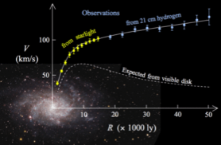
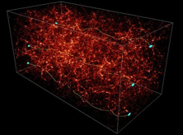
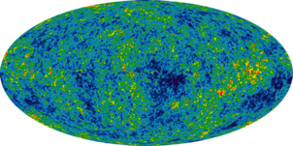
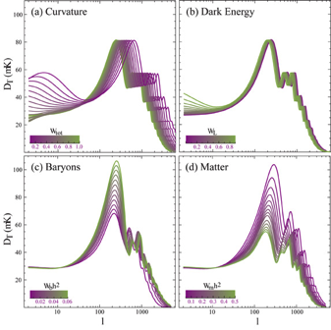
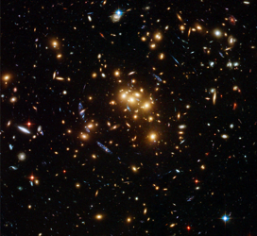
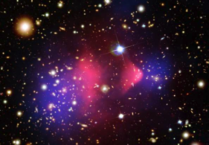
Many pieces of evidence for dark matter
Rotation curves
Large scale structures
Cosmic Microwave Background
Data
Lensing
Colliding clusters (Chandra)

Slide 5
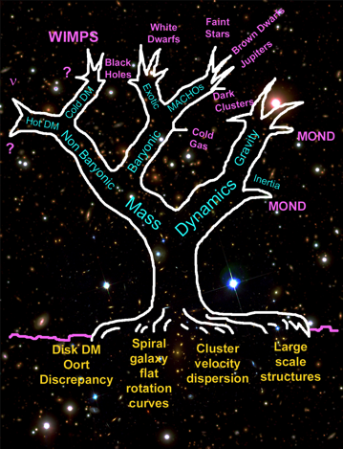
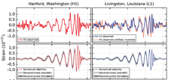
The dark matter problem
Original drawing by Stacy McGaugh (1995)
Astrophysics
Particle physics
Particle physics is not the only possible solution…
Modify gravity
Several hypothesized solutions
Roots are the empirical observations

Slide 6
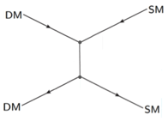
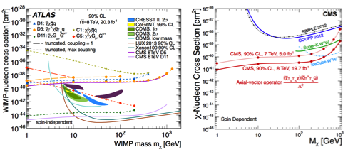
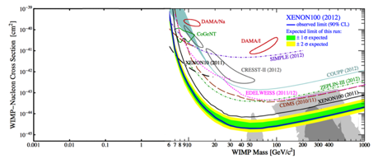
Where to search for dark matter
Without modifying the SM structure: U(1)_{Y}+SU(2)_{L}+SU(3)_{C}
  Dark matter can’t be strong interacting (scattering cross section too high)
  Cannot be electrically charged, otherwise it would not be dark!
  It can be weakly interacting and massive!
WIMP has all the characteristics to solve the DM problem…
… but so far more than 20 years of unsuccessful searches
  Apart from DAMA-LIBRA annual modulation
  Strong constraints from the LHC and direct searches up to TeV scale
annihilation
scattering
collider production
Nuclear recoil too weak
MeV
GeV
TeV
What about introducing a new force?
TeV

Slide 7
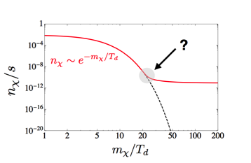



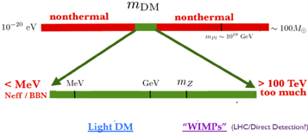
Thermal relic dark matter
DM particles
were created thermally in the early universe
They are in chemical equilibrium with SM particles through 2 → 2 annihilations
At thermal equilibriums same number density as photons:
As the Universe cooled the number of DM particles and photons would decrease together as long as
When the temperature dropped below m_{DM} the number density started to exponentially decrease
No relics today, unless transition out of equilibrium or “freeze-out”, when the probability of annihilation has become small
Freeze-out should complete before neutrino decoupling and Big Bang Nucleosynthesis
m_{χ}=100 GeV,g_{χ}=0.6, Ω_{χ} = 0.1
The annihilation cross section is just what would be predicted for particles with electroweak scale interactions:
the WIMP miracle

Slide 8
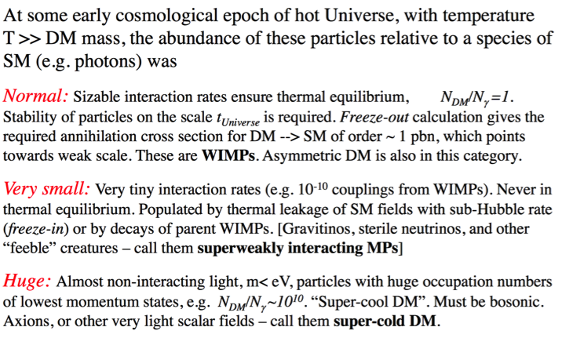
Types of DM
M. Pospelov

Slide 9
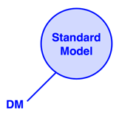
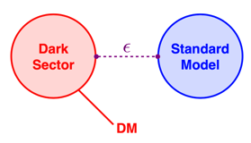




From WIMP to “portal” to hidden sector
A mediator particle, very weekly interacting with SM particles, and connecting with a hidden sector
It can be light… where direct detection gets into trouble
vector
dark photon
Higgs
dark scalar
neutrino
sterile neutrino
axion
ALPs

Slide 10
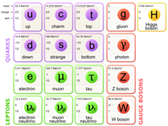
Dark photon
The simplest hidden sector model just introduces one extra U(1) gauge symmetry and a corresponding gauge boson: the “dark photon" or U boson or heavy photon (γ’ or A’)
An extra U(1) symmetry implied in many Standard Model extensions, some classes of string theory, etc.
Two types of interactions with SM particles should be considered
  1. As in QED, generates interactions of the type:
    Not all the SM particles need to be charged under this new symmetry
    In the most general case q_{f} is different in between leptons and quarks and can even be 0 for quarks
    [P. Fayet, Phys. Lett. B 675, 267 (2009).]
  2. Couples to SM hypercharge through kinetic mixing operator, acquiring a (small) SM charge:
    ½ εF^{Y}_{μν}F ’^{μν} ; F ’^{μν}=∂_{μ}A’_{ν}
    A_{μ} → A_{μ} + εa_{μ} ; α’ = ε²α
Dark Sector
Z’?
Dark fermions
χ
?
ψ
?
A’
?
h’?
Standard Model
A’
A’
εe
γ
γ

Slide 11
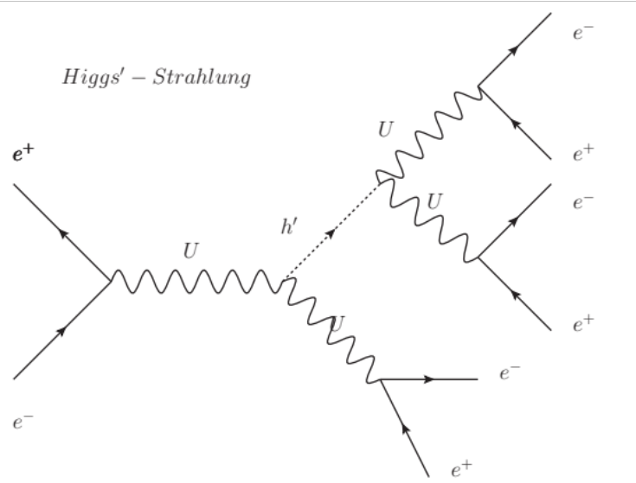
Dark photon with dark Higgs
Model assumes the existence of an elementary dark Higgs boson h’, which spontaneously breaks the U(1) symmetry.
PRD 79, 115008 (2009)
A’ boson produced together with a dark Higgs h’ through a Higgs-strahlung e⁺e⁻→A’ h’
  Cross section =20fb×(α/α_{D})(ε²/10⁻⁴)(10GeV)²/s
  For light h’ and A’ (M_{U,h’}<2Mμ) final state with 3(e⁺e⁻ pair) are predicted
  Background events with 6 leptons are very rare at this low energies
  Due to A’,h’being very narrow resonances strong kinematical constraints are available on lepton pair masses
Experimental search by BaBar and KLOE-2
for A’ masses above 200 MeV
A’
A’
A’
h’

Slide 12
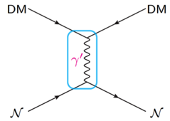
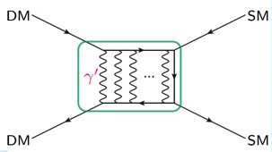
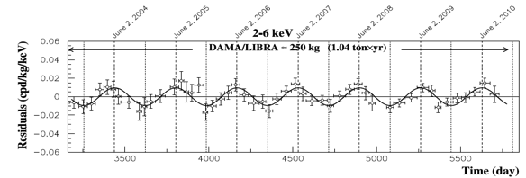
A dark matter “messenger”
A’
A’
Dark Matter scattering on nuclei
Dark Matter annihilation…
Nuclear recoil by the exchange of a dark photon
Independent of χ mass value

Slide 13
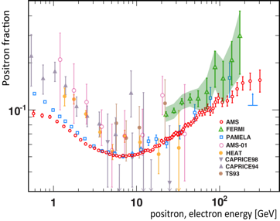
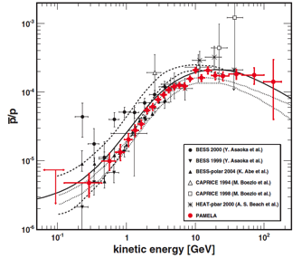
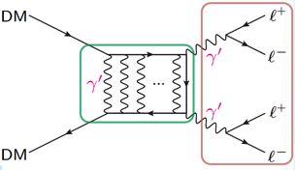
Particle astrophysics: PAMELA, AMS
Positron eccess: PAMELA, FERMI, AMS-02
No significant excess in antiprotons
  Consistent with pure secondary production
Leptofilic dark matter annihilation?
If DM is the explanation, the mediator should be light, < 2m_{proton}
A’
A’
A’
…naturally leptophilic

Slide 14
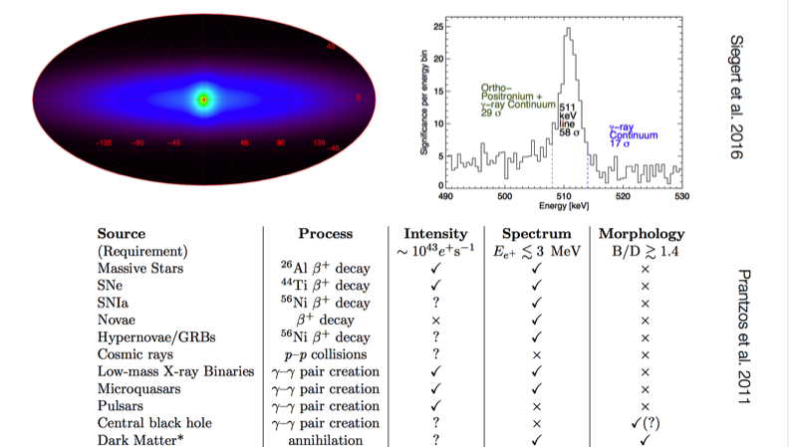

511 keV signal (INTEGRAL/SPI)

Slide 15
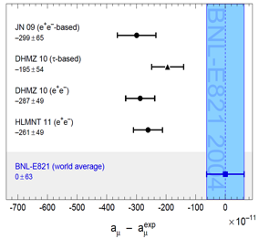
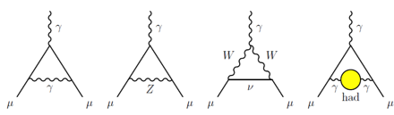
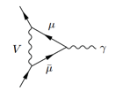
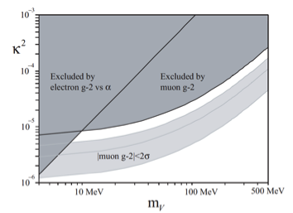
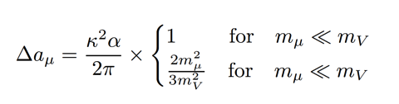
Muon g-2 SM discrepancy
g-2 in the Standard Model
g-2 and A’
A’
About 3σ discrepancy between theory and experiment (3.6σ, if taking into account only e+ e-  hadrons)
Additional diagram with dark photon exchange can fix the discrepancy (with sub GeV A’ masses)
ε²
Contribution to g-2 from dark photon
m_{A’}

Slide 16
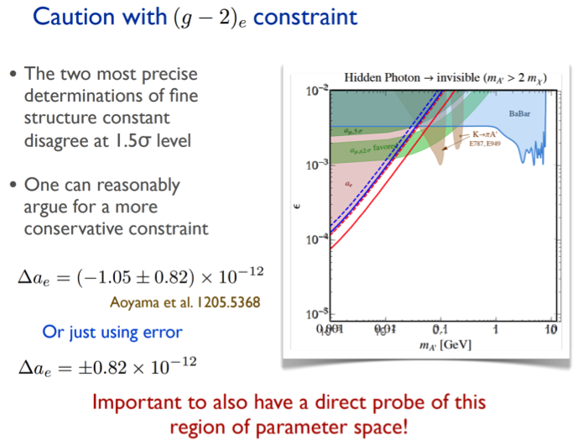
g-2 electron
Brian Batell

Slide 17
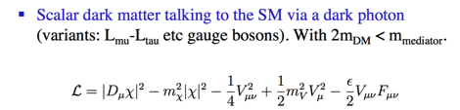
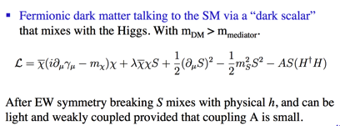


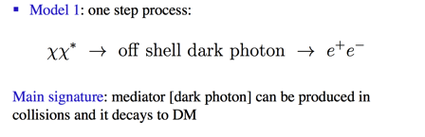
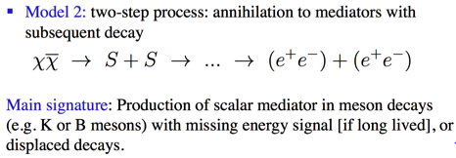


Some examples
M. Pospelov

Slide 18
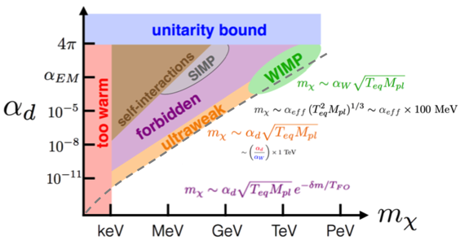





Dark freeze-out
J. Ruderman (NYU)
WIMP
SIMP
3 → 2 freeze out
ultraweak
forbidden

Slide 19
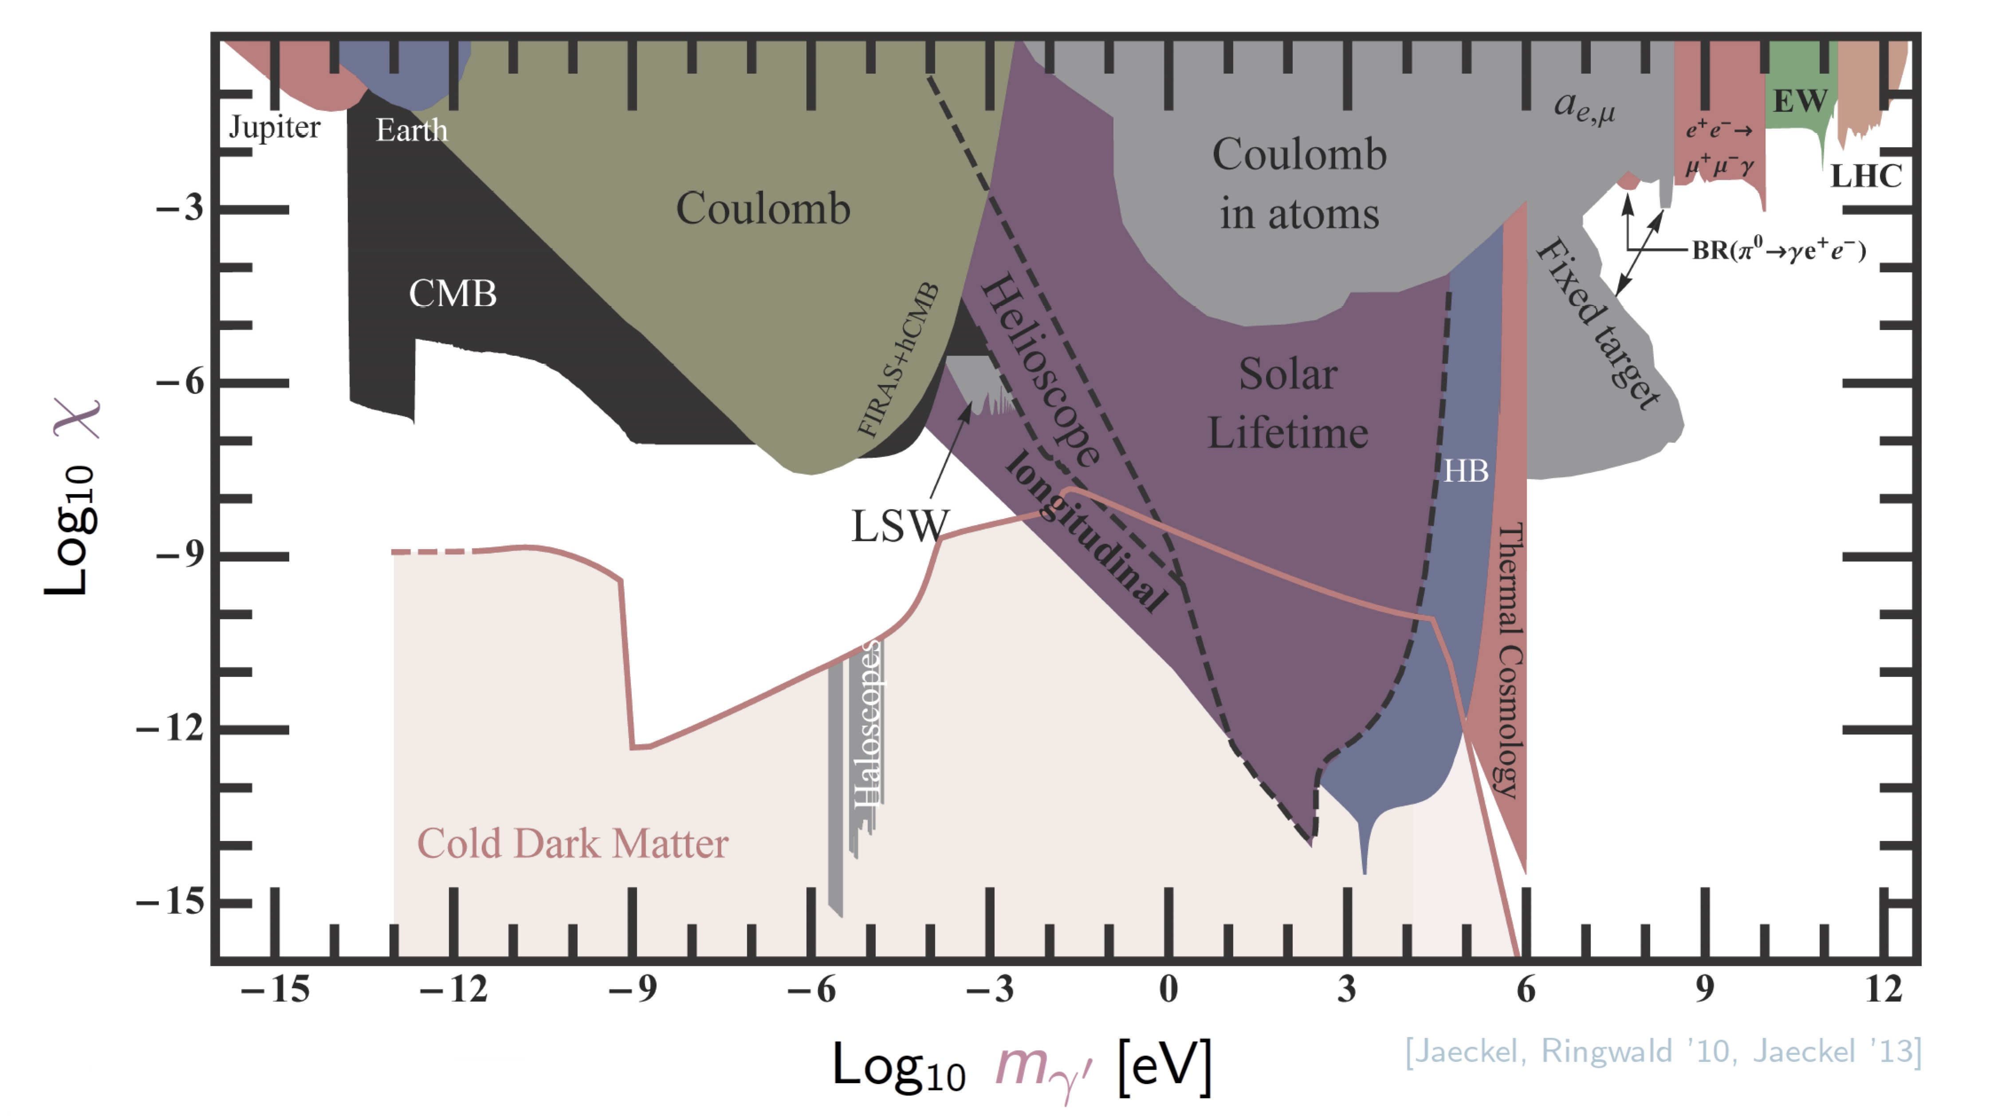

Where to look for dark mediators?
Look here
ε
m_{A’}

Slide 20
Dark photon production
Bremsstrahlung
Annihilation
Meson decay
γ
A’
e⁻
γ
e⁻
π⁰,η
e⁻
γ
A’
A’
e⁺
A’ can be produced in electron collision on target by:
  Bremsstrahlung: e N → e N A’
  Annihilation: e⁺ e⁻→ γ A’
  Meson decays

Slide 21
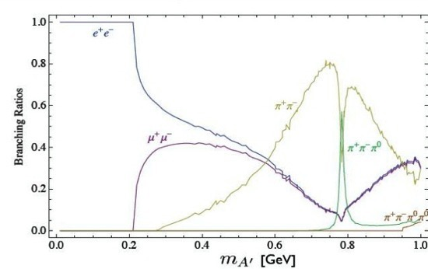
Dark photon visible decays
Assume that no additional lighter states exists in the dark sector with m_{χ}<m_{A’}/2
Dark photon couples to SM particles through kinetic mixing only (with same coupling εq)
For m_{A’}<2 m_{μ} only decays to e⁺e⁻
A portal to the hidden sector:

Slide 22
Dark photon invisible decays
If χ state with U(1) charge q_{U} and coupling constant g_{U} exists in the dark sector with m_{χ}<m_{A’}/2, the coupling to the A’ will be: q_{U}g_{U}
A’→χχ will be dominant wrt to visible decays for α_{D}>α, i.e. |q_{U}g_{U}|>εe
_
χ
SM
A’
_
A’
χ
SM

Slide 23
Dark sector experiments
Thick target (beam-dump)
  Produced by electron beam
  Absorb all SM backgrounds
  Look for visible decays (e+ e−, μ+ μ−, …)
Thin target + decay:
  Produced by electron beam
  Do not absorb shower
  Decay to visible particles (e+ e−, μ+ μ−, …)
    “Bump hunting”, looking for a peak in the invariant mass
    Displaced vertices, looking for long-lived particles
  Decay to invisible particles
    Look for missing mass
    DM particles recoil
Meson decays (visible and invisible)
Dark particles scattering (invisible)

Slide 24
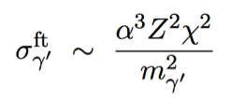
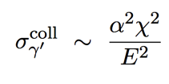
Why fixed target?
Bremsstrahlung
Annihilation
Meson decay
γ
e⁻
e⁻
A’
γ
e⁺
π⁰,η
e⁻
A’
e⁻
e⁻
A’
e⁻
γ
e⁺
e⁺
e⁺
ε
ε
A’
A’
O(pb)
O(fb)

Slide 25
Fixed target experiments
Radiative background
e⁻
Main backgrounds: SM Bremsstrahlung + Bethe-Heitler
Kinematics:
  A’ takes nearly all the beam energy E₀ (sharply peaked at x≈1)
  Electron takes a small energy ≈ m_{A’}
  A’ emission almost collinear to the beam: θ_{A’}=(m_{A’}/E₀)^{3/2}
  Electron going at “wide” angle: θ_{e}=(m_{A’}/E₀)^{1/2}
  A’ decay products open by θ ≈ m_{A’}/E₀
e⁺
e⁻
e⁻
γ
Bethe-Heitler background
e⁻
e⁻
E₀
E’
Target
θ
θ_{A’}
e⁺
θ_{e}
e⁻
E

Slide 26
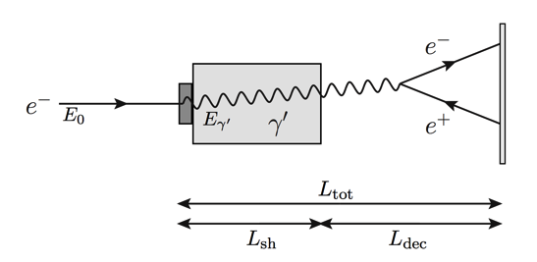


Electron beam-dump experiments
Shield
Target
Decay region
Detector
Luminosity:
At colliders:
Beam
section
In addition to cross section advantage

Slide 27








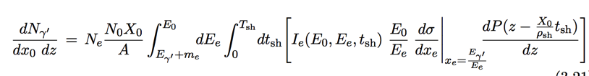

Electron beam-dump experiments
Electron energy distribution due to the interaction in target+shield
Decay probability of γ ’ after shield
dσ/dx for γ ’ production by Bremsstrahlung

Slide 28
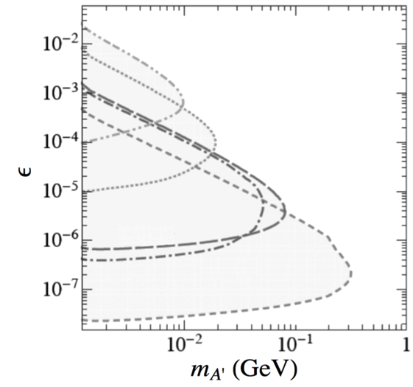


Limits from electron beam-dump experiments
decay in dump
L_{sh}
E₀
Not enough energy
N_{e}
L_{dec}
rate too small
decay too far

Slide 29
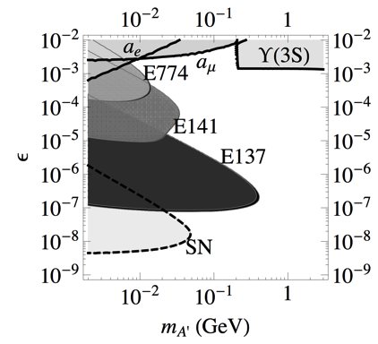
Limits from electron beam-dump experiments
Beam-dump experiments: looking for decay products of “rare penetrating particles” behind a stopped electron beam
SLAC E141 (1987) and SLAC E137 (1988), Fermilab E774 (1991)
5×10⁹
275 GeV
2×10¹⁵
9 GeV
2×10²⁰
20 GeV
μ⁺μ⁻
hadrons

Slide 30
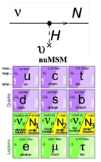
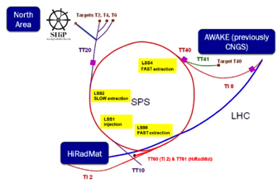





Proton beam dump: SHIP
Main aim: look for heavy neutral leptons
Dark photon sensitivity

Slide 31
Thin target experiments
Running:
  APEX at JLAB Hall-A, test run done, full run coming
  A1 at MAMI
  HPS at JLAB Hall-B, first runs done in 2015 and 2016
Coming soon:
  PADME at Frascati (approved)
Proposed:
  DarkLight at JLAB FEL (electron on gas jet target)
  VEPP3 (electron on gas jet target)
  Cornell (positron extracted from synchrotron)

Slide 32




APEX
0.3<p<4.0 GeV, θ₀=5°
Acceptance=4.5 msr
δp/p < 2×10⁻⁴
δφ=0.5 mrad, δθ=1 mrad

Slide 33



APEX
QED
accidentals

Slide 34


MAMI A1
JLAB Hall-A APEX
n×1.1 GeV, continuous, 200 μA beam
MAMI A1
855 MeV, continuous, 90 μA beam

Slide 35



HPS
Increase acceptance wrt double arm spectrometer
Look for displaced vertex
θ of the decay is small:
  put detectors as close as possible, good forward coverage
  Aim at minimum θ_{A’} ≈ 15 mrad
Bump hunting needs good momentum/mass resolution
Good tracking and analyzing magnet
Aim at Δm/m ≈ 1% and Δz ≈ 1 mm
Trigger with a high rate ECAL
Magnet+ECAL to select e⁺ and e⁻
Magnet+muon detector to select μ⁺ and μ⁻

Slide 36




HPS
Detectors split in two halves to let the beam pass through

Slide 37



HPS background & exclusion

Slide 38

DarkLight
FEL electron beam, 100 MeV, continuous, 10 mA, onto 10¹⁹ H₂/cm² gas jet target
Proton recoil detector. Full reconstruction of event for background rejection
Vertex ing and low momentum lepton tracker: TPC
Outer trackers
Test performed on prototype vacuum chamber to assess beam transport feasibility

Slide 39

Summary on visible decays
Practically, all the (g-2)_{μ} favored band already excluded
Still large interest for excluding the uncovered parameter space
… but limits work only if the dark photon is the lightest particle in the hidden sector
MESA

Slide 40








Invisible decays: a dark matter beam
Positive evidence
Negative evidence
NA64
Dump & scattering, N ∼ ε⁴
BDX
Missing energy, N ∼ ε²
LDMX
BaBar,
Belle-II,
PADME
Missing momentum, N ∼ ε²
Missing mass, N ∼ ε²

Slide 41






DM scattering experiment: BDX at JLAB
Scattering on nuclei
Backgrounds:
Neutrino production
Cosmogenic muons and neutrons
Scintillator 1 m³
1 MeV/10 MeV e⁺e⁻ detection threshold
LOI presented to JLAB PAC

Slide 42


Scattering experiment: BDX at JLAB
High energy beam advantages:
- Higher cross sections
- χ beam boosted, larger acceptance
Cross section dependence from A’ mass
Cross section dependence from A’ mass, χ mass, coupling constant

Slide 43



BDX
10²² EOT = 1 beam-year at Hall-A
3 beam-years at Hall-C?
Dark matter searches at (low energy) accelerators

Slide 44



BDX signal

Slide 45



BDX backgrounds
Beam related
Cosmogenic

Slide 46




BDX sensitivity

Slide 47



Proton beam dump experiments
Use data of the search of ν_{H}→νe+e− for looking for P→γA’
Pseudoscalar decaying to spin 0 or ½ particles negligibly small
A’

Slide 48


Limits from past experiments: proton beam dump
NOMAD and PS191 looked for decay of and heavy neutrino ν_{H}→νe+e−
Look for π⁰→γA’
NOMAD: 4.1⋅10¹⁹ POT
E>4 GeV, m_{ee}<95 MeV
PS191: 0.89⋅10¹⁹ POT

Slide 49




Beam dump: MiniBooNE

Slide 50



MiniBooNE

Slide 51



Invisible decays, model dependence of limits
K±→π±νν used to constrain K±→π±A’ assuming kinetic mixing and coupling to quarks ≠ 0
Add Z mixing
m_{χ} dependence

Slide 52

Combine visible and invisible decays
m_{χ} dependence

Slide 53


Model independent limits from invisible decays
MiniBooNE
Direct searches for A’ invisible decays only depend on ε² and m_{A’}
No assumptions on coupling to quarks (Both Υ_{3S} and K± results rely on that)
(g-2)μ favored band excluded
But still plenty of parameter space unconstrained

Slide 54


NA64 at CERN SPS
H4 high purity electron beam, <1% contamination required
(tertiary, from γ conversions)
Main backgrounds:
punch-through of e⁻ or γ
Non-hermeticity of HCAL
Low energy tail of e⁻ beam
e⁻ induced photo-nuclear reactions
Muon events

Slide 55

Missing momentum vs. missing energy
LDMX can do both

Slide 56


LDMX

Slide 57


LDMX background rejection

Slide 58

A challenge also for simulation

Slide 59



Tim Nelson

Slide 60

LDMX sensitivity
Phase II
>2021
>2025

Slide 61
The missing mass approach
  No assumption on the A’ decays products and coupling to quarks
  Only minimal assumption: A’ bosons couples to leptons
  Limits the coupling of any new light particle produced in e⁺e⁻ collision (scalars (H_{d}), vectors (A’ and Z_{d})
γ
e⁺
Just detect one photon + missing energy:
e⁺ e⁻ → γ + nothing
e⁻
In order to compute M²_{miss} = (P _{γ} – P _{e+})² we need:
  A positron beam with a well defined four-momentum
    Small energy and angular spread
    Small transverse spot
  1+2 = small emittance
    Tunable intensity (in order to optimize annihilation vs. Bremsstrahlung)
  Measure precisely the photon (tri-)momentum (angle and energy)

Slide 62
Backgrounds
γ
e⁺
e⁻
We need to fight the backgrounds
i.e. one photon + something else, eventually going undetected:
e⁻
γ
γ
e⁻
γ
γ
e⁺
e⁺
γ
γ
e⁺
e⁺
γ
γ
+1 electron
Bremsstrahlung process, ≈Z²
+1 γ
γγ process, ≈Z
+2 γ
3γ process

Slide 63


BaBar single photon events

Slide 64

The PADME experiment
  10³-10⁴ e⁺ on target per bunch, at 50 bunches/s (10¹³-10¹⁴ e⁺/year), limited by pile-up, mainly due to Bremsstrahlung events
Active target, thin: e.g. 50-100μm diamond with strips
  Optimize by looking at annihilation vs. Bremsstrahlung cross section
Magnetic spectrometer/veto ~ 1m length × 0.5 T for sweeping away 550 MeV beam
  Conventional magnet with large gap for gaining acceptance
  Possibility to increase field for energy upgrade to ~ 1 GeV
  Available from CERN, spare of MBP dipoles of SPS transfer line
Cylindrical crystal calorimeter
  Optimize radius vs. distance by looking at background rejection vs. acceptance
  In order to have an acceptable rate, central hole and
Small angle detector for Bremsstrahlung veto
Vacuum pipe

Slide 65

First task, measure the recoil photon
Our main detector is of course a calorimeter, with two basic requirements:
1. Measure E_{γ}, θ_{γ}
  Good energy resolution: 1-2%/√E[GeV])
    High Photo-statistics
    Containment
  Good angular resolution: ≈1 mrad
2. Fight pile-up
  Sub-ns timing resolution
γ
The material choice fixes light yield & time resolution, Moliére radius & X₀
The Moliére radius determines granularity
The granularity + required angular resolution, set the distance from the target
Given the distance, the lateral size fixes the angular coverage (i.e. acceptance)
But…
…we have to take into account two important constraints:
The overall size of the experiment is the hall length (<5 m)
Another important bound is the cost, which is driven by the material, size and granularity (i.e. the number of channels)
e⁺
Target
So the message is “keep it compact!”

Slide 66



The calorimeter
LYSO(Ce): high LY, high ρ, small X₀ and small R_{M}, short τ_{decay}
Performance:
  σ(E)/E =1.1%/√E ⨁ 0.4%/E ⨁1.2%
BGO: high LY, high ρ, small X₀ and small R_{M}, long τ_{decay}
Resolution also in 1-2%/√E range
Small Moliére radius and high light yield:
LYSO and BGO
Granularity ≈R_{M} → 2 cm
a=2 cm → point resolution: 2 cm/√12=6 mm
σ_{point}=6 mm → 1 mrad at 6 m distance → too much!
But…
...we have clusters!
Center of gravity should have a better resolution
Most of the energy will be in a single crystal, pulling the cog towards the center of the most energetic one)
Results with a Geant4 “photon gun”, E=500 MeV
σ_{cluster}≈4.5 mm (including the systematic shift), better than 6 mm

Slide 67




Longitudinal containment
15 cm long crystals (13.2 X₀)
20 cm long crystals (17.5 X₀)
No energy dependence of response
Longitudinal leakage
Correct energy scaling

Slide 68

Signal acceptance in calorimeter
Calorimeter hole:
20 mrad
θ_{max}=65, 75, 83 mrad
from 58% to 65% acceptance
But wait! What about the backgrounds?
Calorimeter
Target
Target
Small angle

Slide 69



Calorimeter 2γ and 3γ backgrounds
Lost
θ>100 mrad
Region 1
<20 mrad
Region 3
θ>75 mrad
1+2
2+3
3
1+2+3
Lost
1
2
No 2γ events
Recoil γ definition:
10 MeV < E < 400 MeV
30 mrad < θ < 65 mrad
Per-mil 3γ background

Slide 70

Residual background
Tighter signal definition: in fiducial region and 150 MeV < E < 450 MeV
1+2
2+3
1+2+3
Lost

Slide 71


L3 BGO crystals
700 BGO crystals from former L3 electromagnetic calorimeter
Cut from trapezoidal prism shape to square section 21×21 mm², 220 mm long
Mounting and support structure

Slide 72






Missing mass resolution
BGO
LYSO
L3 BGO
M_{miss} resolution is the result of combination of angular resolution, energy resolution and angle-energy correlation due to production
τ=300 ns light signal
3×3 matrix total charge (150 MeV)
Aim at 1 MeV threshold:
²²Na 511 keV calibration

Slide 73







The diamond target
Given the number of positrons, 50-100 μm of Carbon
Given the beam spot size and shape, at least cm² area
20×20 mm², 50 μm detector tested on beam
16 strips per side, 1 mm pitch is the baseline design
Resolution adequate for monitoring beam spot
50 μm, silver painted,
Estimated CCD=10-20μm
Digitized strips signals
Center of gravity
Average position

Slide 74






Positron veto
  Time resolution better than 500ps
  Momentum resolution of few % based on impact position
  Efficiency better than 99.5% for MIPs
  Low energy part inside the magnet gap
  High energy part close to not interacting beam
High energy
Full MC with magnetic field map
100 cm
Low energy

Slide 75


Positron veto
Low momentum losses are reduced for E_{γ}<400 MeV
Interesting positron energy starting at ~150 MeV
Which granularity?
1 cm scintillator bars, readout by SiPM
Few % momentum resolution in a large part of the spectrum

Slide 76

Background estimates
BG sources are: e⁺e⁻→γγ, e+e-→γγ(γ), e+N→e+Nγ, Pile up
Pile up contribution important; rejected by the maximum cluster energy cut and M²_{Miss}
Veto inefficiency at high missing mass (E(e+)≃ E(e+)beam
Full Geant-4 simulation

Slide 77


PADME-invisible decay sensitivity
Based on 2.5x10¹⁰ fully GEANT4 simulated 550MeV e+ on target events
  Number of BG events is extrapolated to 1x10¹³ electrons on target
  Using N(A’γ)=s(N_{BG})
  δ enhancement factor δ(M_{A’}) = σ(Α’γ)/σ(γγ) with ε=1
Running time depending linearly on positron pulse length

Slide 78


PADME@Cornell
@Cornell
E_{beam} ~ 6.0 GeV (from 5.3 GeV)
CM energy ~ 75 MeV
2° < θ_{ϒ} < 5°
10 MeV < E_{ϒ} < 800 MeV

Slide 79







A 16.6 MeV boson?
Electron spectrometer
MWPC + scintillators
On resonance
Off resonance
E_{p}=1.04 MeV
E_{p}=1.10 MeV
E_{p}=0.8 MeV

Slide 80



Proto-phobic boson
6.8σ excess, interpred as a new (vector is favored) boson
Not compatible with present limits: too high coupling unless…
A. Krasznahorkay et al., “Observation of Anomalous Internal Pair Creation in ⁸Be: A Possible Indication of a Light, Neutral Boson”,
Phys. Rev. Lett. 116, 042501 (2016)
J. Feng et al., “Protophobic Fifth Force Interpretation of the Observed Anomaly in ⁸Be Nuclear Transitions”,
Phys. Rev. Lett. 117, 071803 (2016)
⁸Be

Slide 81

Time of facilities
2022
2021
VEPP-3
?
MESA
?
Fermilab
Running
SPS, PSI
CESR
DAΦNE
LCLS-II
CEBAF
LERF
Running
2018
Super-KEKB
2021
2019
Electrons (FT)
Positrons (FT)
Electrons and positrons (collider)
Protons

Slide 82
Facilities for dark sector/LDM searches
Existing accelerators
  CEBAF & LERF@JLAB
  DAΦNE LINAC
  SPS extracted beams@CERN
Approved new accelerators
  MESA@Mainz
Proposed accelerators upgrades
  DASEL@SLAC
  BDF@CERN (SHiP)
  Positrons from Synchrotron@Cornell
  VEPP-3 bypass
  Positrons from DAΦNE ring?

Slide 83

Future projects combined sensitivity

